Slide 1
TREE BANK APP: User-guide FOLLOW US ON La Familia Tree Bank
2019
#N2019-325
August 2019
01/01/2018
01/01/2018
01/01/2018
www.website.com
www.website.com
Camarines Norte State College
www.website.com

Slide 2
PLEASE FOLLOW STEPS 1-3 for planting
August 2019
01/01/2018
01/01/2018
01/01/2018
www.website.com
www.website.com
Camarines Norte State College
www.website.com

Slide 3
TREE BANK APPLICATION OVERVIEW
TREE BANK APP is an Android Based Tool developed to monitor student/employee compliance with the Tree Planting requirement in accordance with applicable laws.
The Tree Bank App is an expanded geo-tagging tool with features and functions designed for monitoring of Tree Planting activities, initially for student and personnel’s and it is intended to implement to all SUCs/HEIs, Primary and Secondary Schools.
Copyright # N2019-325
August 2019
01/01/2018
01/01/2018
01/01/2018
www.website.com
www.website.com
1
Camarines Norte State College
www.website.com

Slide 4
STEP 1 SETUP YOUR CONNECTION
August 2019
01/01/2018
01/01/2018
01/01/2018
www.website.com
www.website.com
Camarines Norte State College
www.website.com

Slide 5
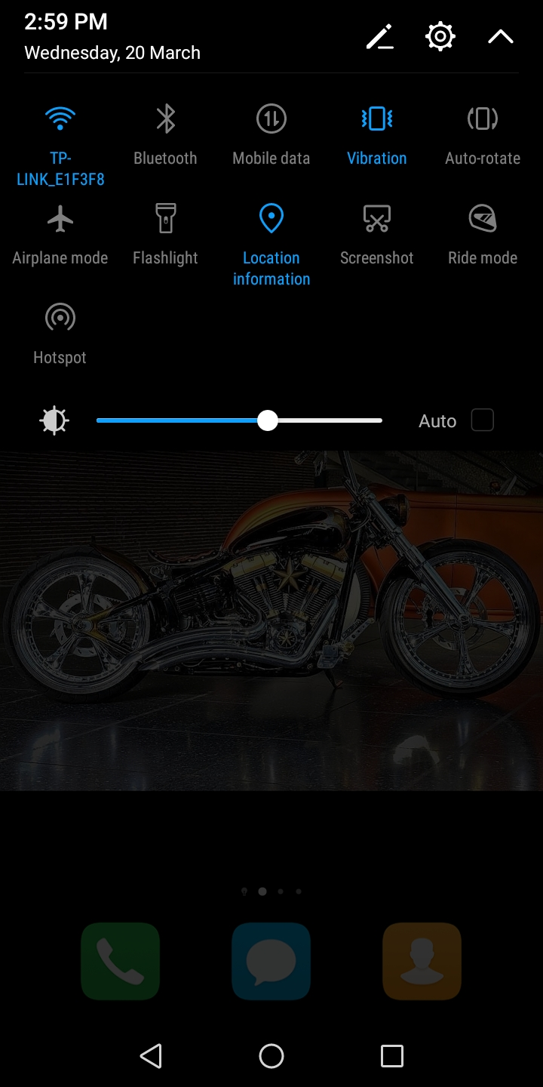
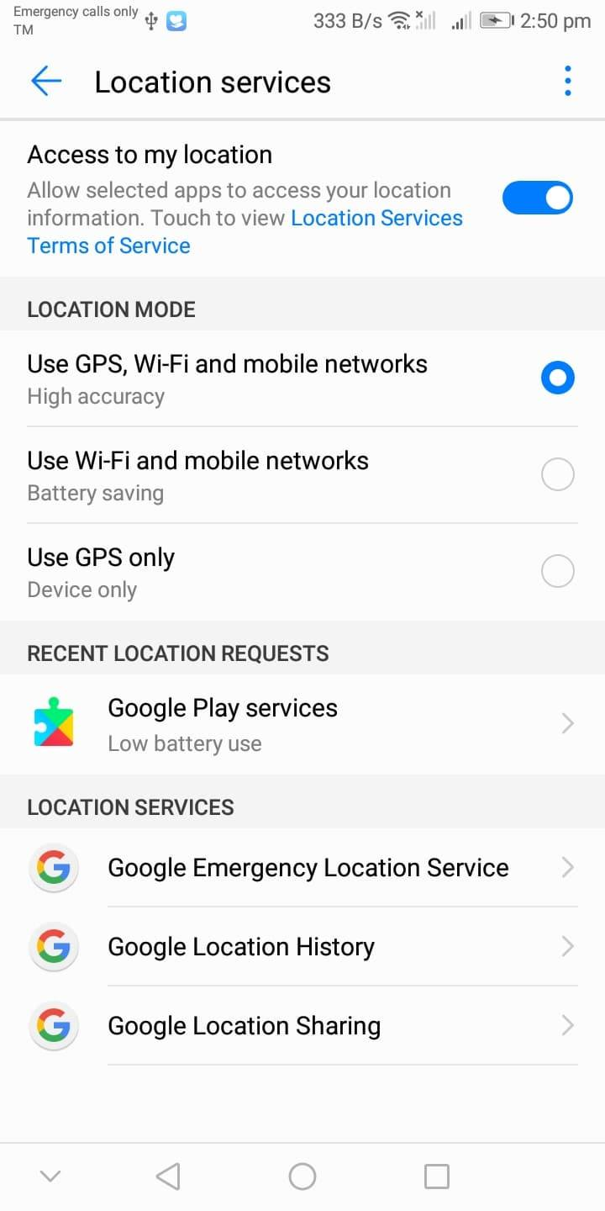
CONNECT
STEP
1
Open your GPS/Location Information.
Connect to a Wi Fi / open data connection.
August 2019
01/01/2018
01/01/2018
01/01/2018
01/01/2018
5
01/01/2018
www.website.com
www.website.com
www.website.com
www.website.com
Camarines Norte State College
www.website.com

Slide 6
STEP 2 CREATE ACCOUNT
August 2019
01/01/2018
01/01/2018
01/01/2018
www.website.com
www.website.com
Camarines Norte State College
www.website.com

Slide 7
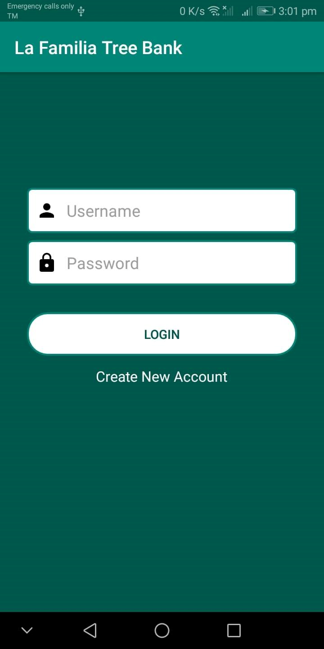
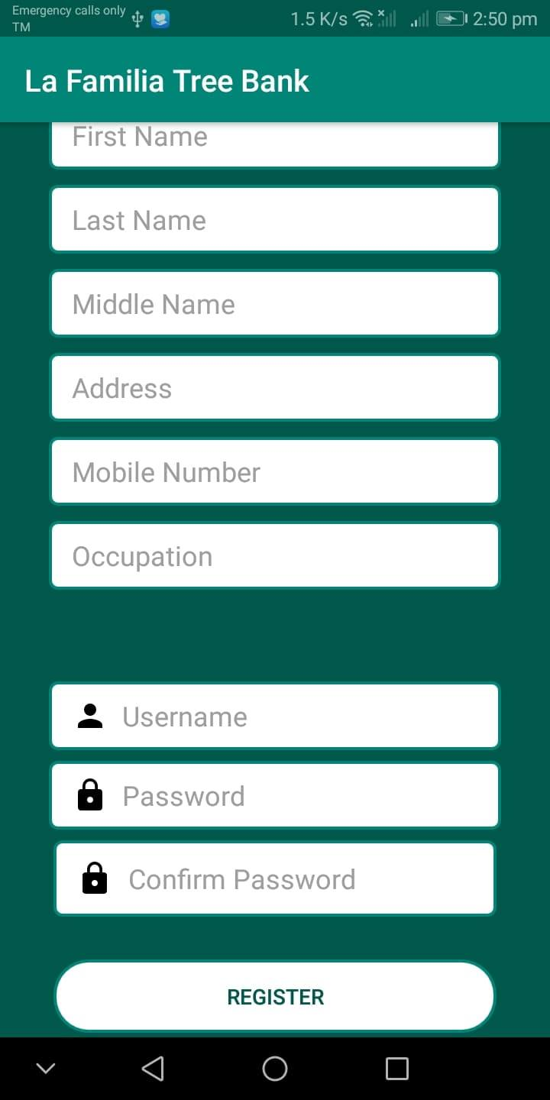
CREATE ACCOUNT
STEP
2
CREATE AN ACCOUNT AND LOG IN
It is important that you use your complete name since it is part of the identification details of the tree and is intended for clearance purposes.
August 2019
01/01/2018
www.website.com
18
Camarines Norte State College

Slide 8
STEP 3 CAPTURE YOUR TREE
August 2019
01/01/2018
01/01/2018
01/01/2018
www.website.com
www.website.com
Camarines Norte State College
www.website.com

Slide 9
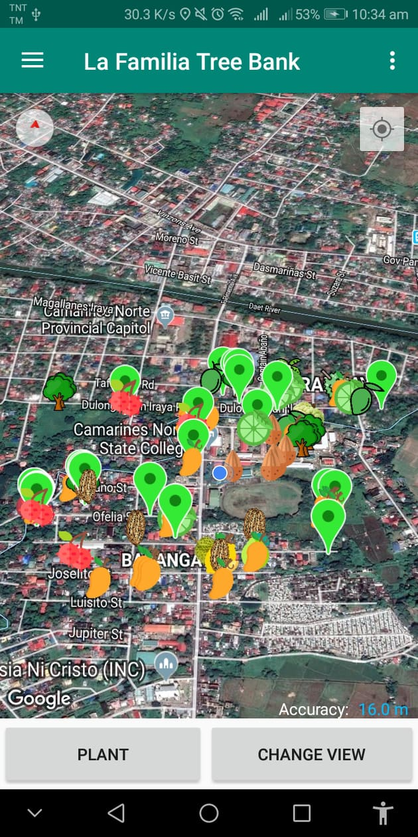
DOCUMENTING (BANKING)
STEP
3
START TO CAPTURE YOUR TREE. TAP Plant button.
NOTE: Plant button is disabled until it reach the 7 meter location accuracy level.
August 2019
01/01/2018
www.website.com
24
Camarines Norte State College
Notes:
After capturing the trees around the area of the chosen place to plant the tree, Press “Plant”.
TB Apps determines the appropriate area for planting by automatically detecting the distance between tress in the area. (if there are existing trees in the area with 1 meter distance (or depending on the variety of tree/s) the planter has to get the coordinates of the existing trees immediately adjacent to the chosen site.

Slide 10
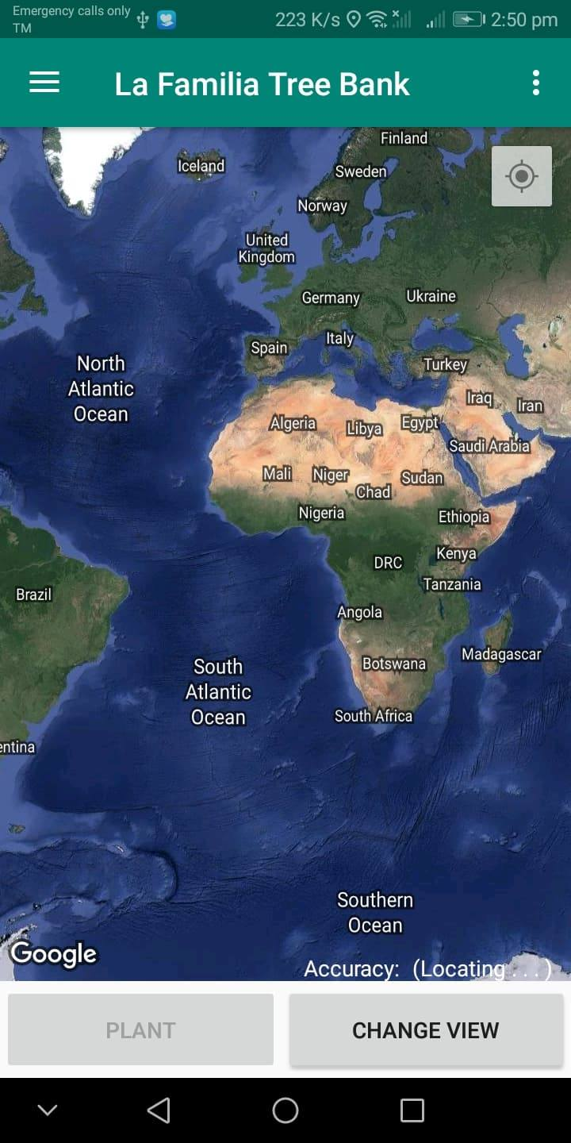
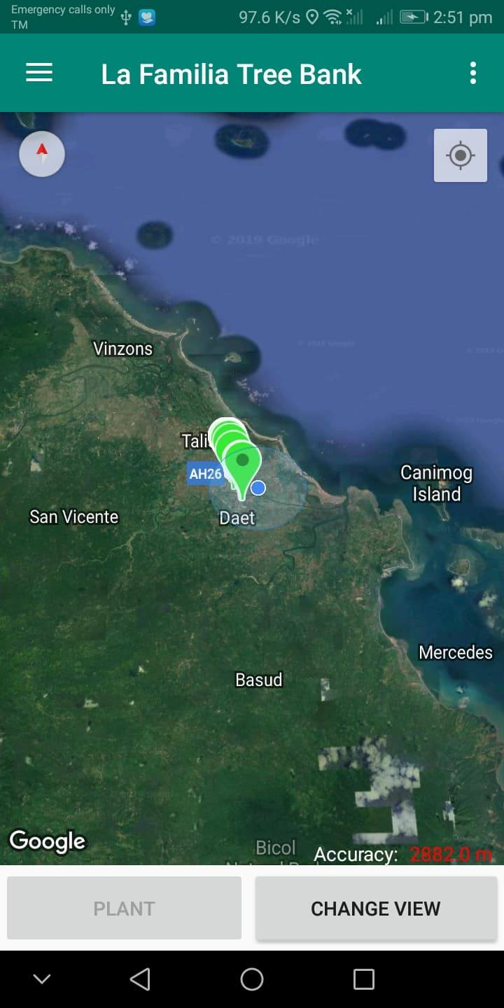
NOTES:
After logging in, a map will display.
Make sure that your GPS is open to locate your current position. Once the app locates where you are it will zoom-in to your location.
Your current position indicates dark blue circle marker while light blue circle marker is the location accuracy.
August 2019
01/01/2018
www.website.com
22
Camarines Norte State College

Slide 11
Nearest 20 trees from your location are also displayed in the Map. Markers are according to the Tree (e.g. Mango, Cacao, etc. Green common marker just means no available icon.)
Prior to planting new trees, all trees within the 2-4 meter radius must be captured.
August 2019
01/01/2018
www.website.com
23
Camarines Norte State College
Notes:
By simply clicking a place in the map, the Apps displays the trees within 20 meter radius. Each type of tree is represented by an icon.

Slide 12
The TB Apps identifies the acceptable accuracy when the color of the accuracy text turns to blue. Make adjustment until it reaches 7 m.
August 2019
01/01/2018
www.website.com
25
Camarines Norte State College

Slide 13
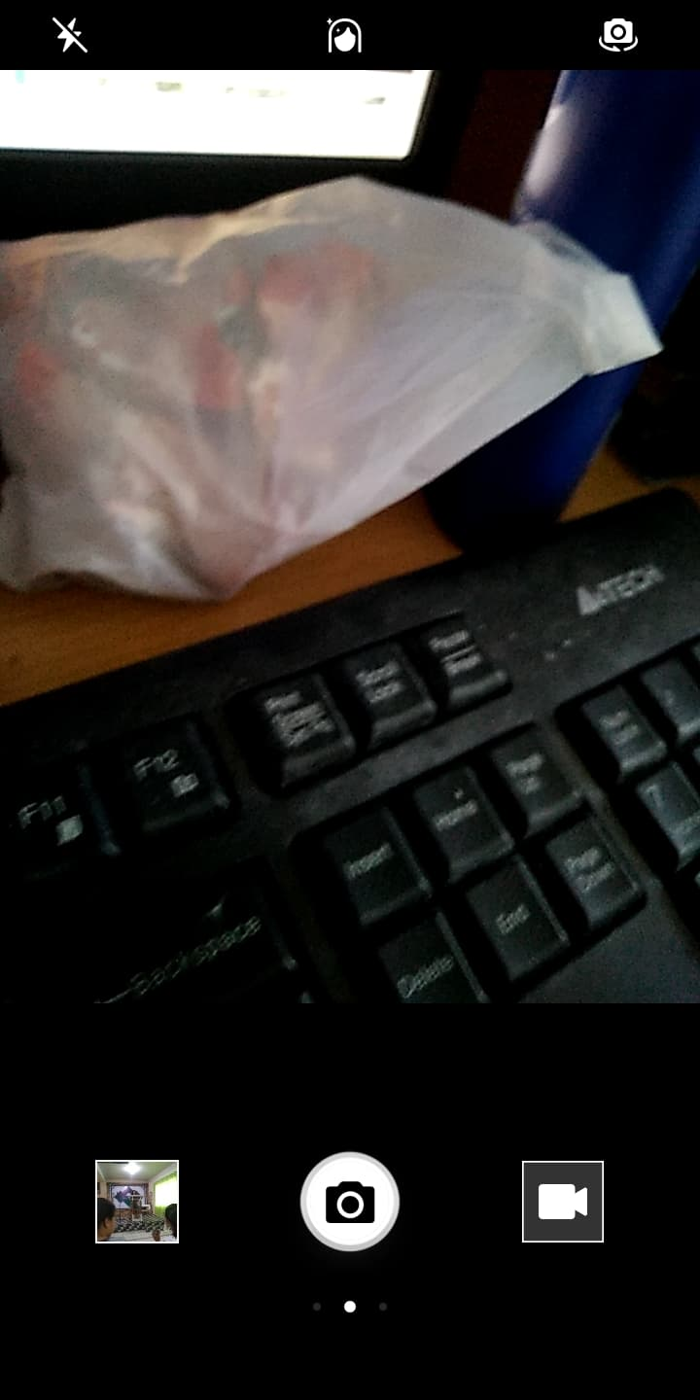
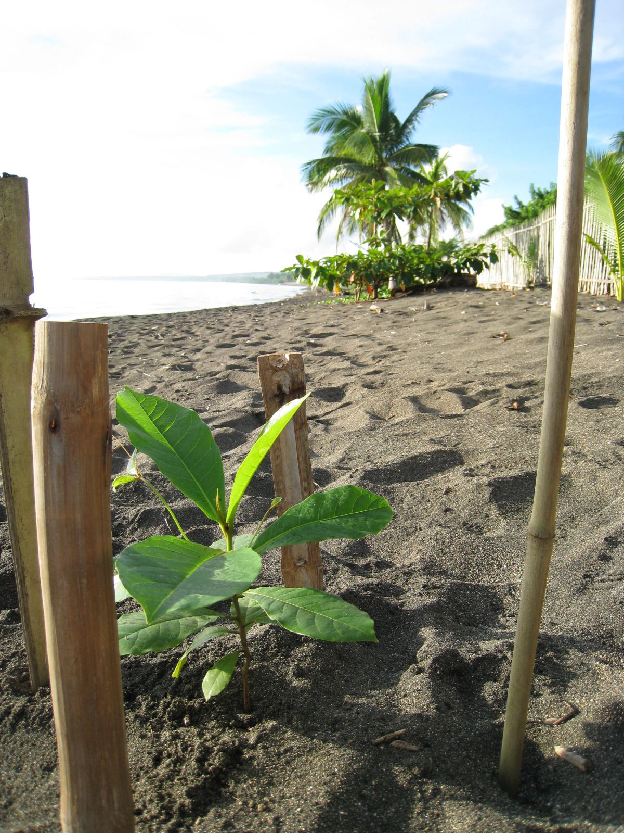
TAKE PICTURE
30 cm.
August 2019
01/01/2018
www.website.com
26
Camarines Norte State College

Slide 14
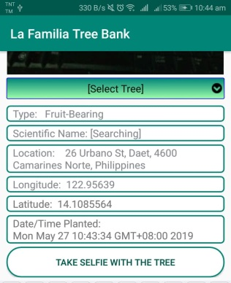
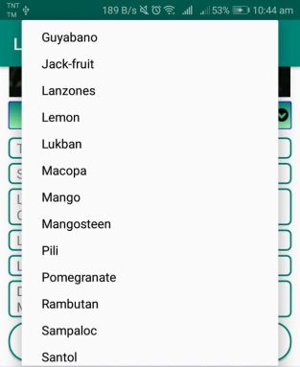
After capturing the plant, create Tree Name and select tree. Everything will be automatically inputted such as Type, Scientific Name, Location, Latitude, Longitude, and Date/Time Planted.
August 2019
01/01/2018
www.website.com
27
Camarines Norte State College
Notes:
*may include other types of trees such as shrubs, bamboos and mangrove trees. Search for the different type of trees.

Slide 15
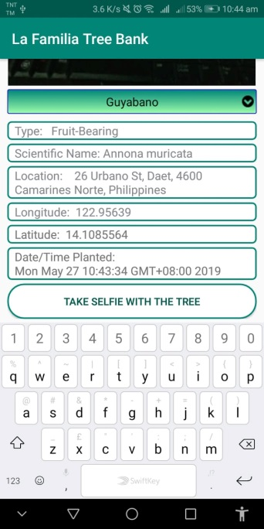
SELFIE
STEP
10
Tap down to see the button “Take Selfie with the Tree”. And take your selfie with the tree.
August 2019
01/01/2018
www.website.com
28
Camarines Norte State College

Slide 16
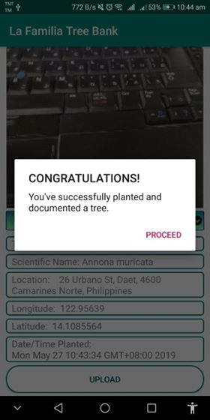
After selfie, click UPLOAD to finally document your tree and you’re done.
Wait for the confirmation and your done.
Please answer the Survey Question after the confirmation.
August 2019
01/01/2018
www.website.com
29
Camarines Norte State College

Slide 17
YOUR DONE!
August 2019
01/01/2018
01/01/2018
01/01/2018
www.website.com
www.website.com
Camarines Norte State College
www.website.com

Slide 18
NOTES FOR MONITORING
August 2019
01/01/2018
01/01/2018
01/01/2018
www.website.com
www.website.com
Camarines Norte State College
www.website.com

Slide 19
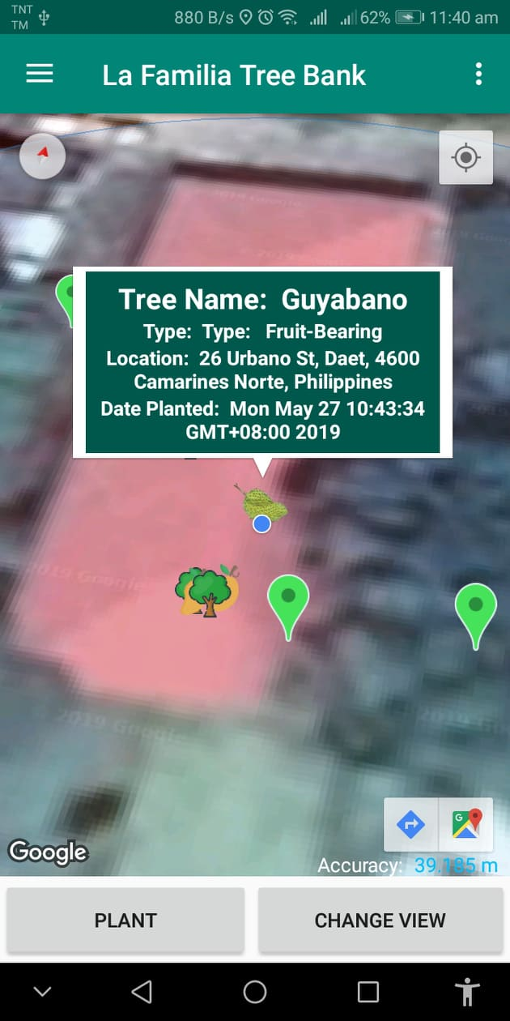
Your tree is saved to the database and you can view it in the map. (For easy locating the your trees, just go the Menu> My Trees and another map will display just for only for your trees planted.)
Just tap the coordinates/tree icon of the tree. Then, Basic Information will appear in a box.
*the tree may have its nickname.
August 2019
01/01/2018
www.website.com
30
Camarines Norte State College
Notes:
The planter shall be required to put a nickname on every tree he/she planted.

Slide 20
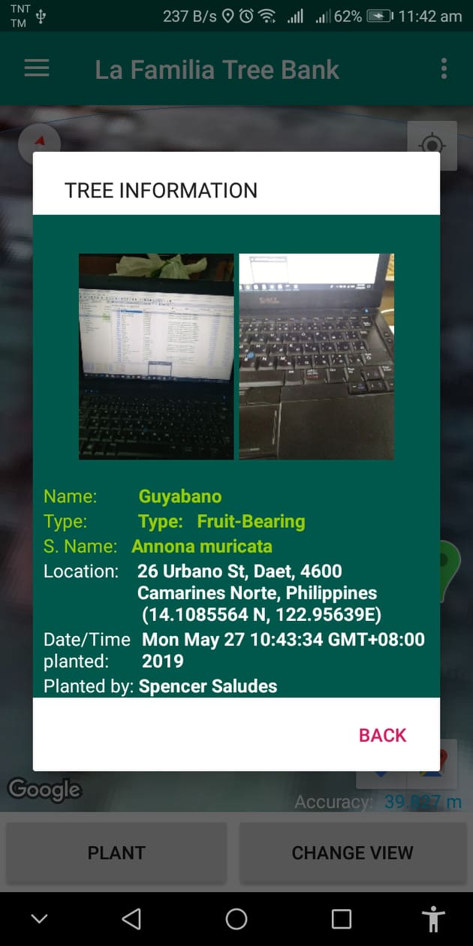
To view the Photo, just tap the Information Box.
It will display the documented file, selfie and the full information of the tree.
*include occupation of the planter. Student/s should include course, year level.
Planter profile must be updatable.
August 2019
01/01/2018
www.website.com
31
Camarines Norte State College

Slide 21
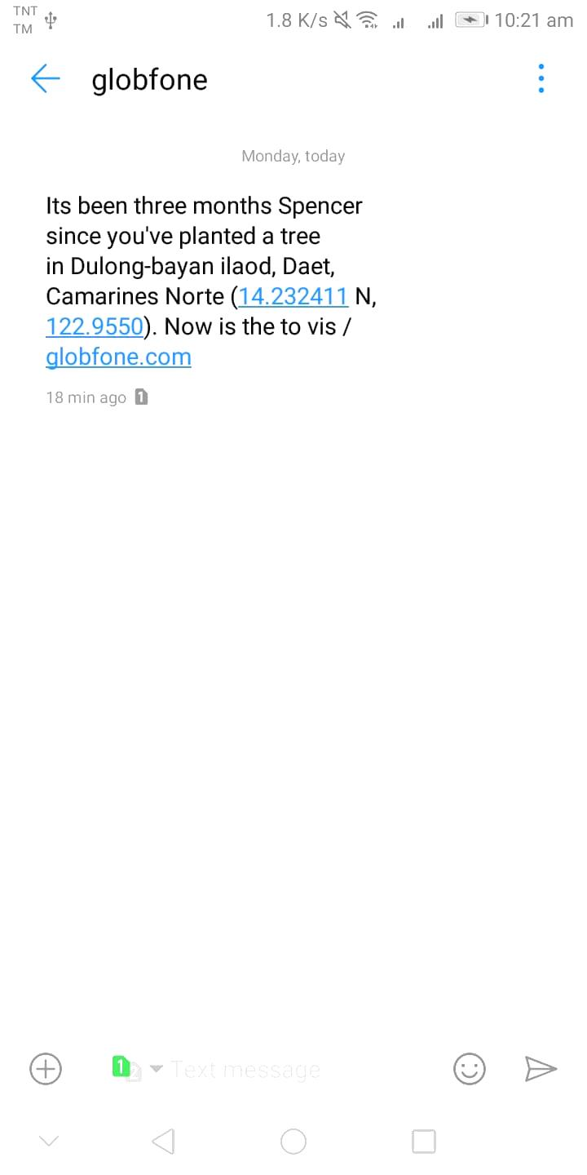
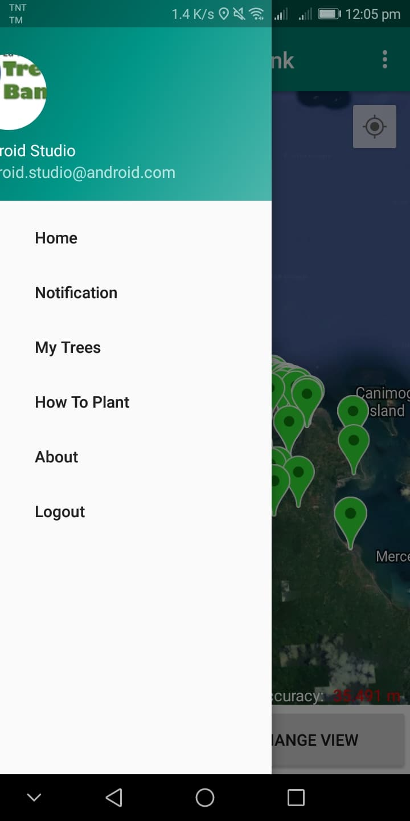
MONITOR/ NOTIFICATION
LF Tree Bank
After 2 months or earlier, the tree-saver will received a SMS Notification to visit his/her tree and have an update what happened to the tree. Message reminders includes coordinates and location of the tree.
To update the tree, go to Menu -> My Trees
Its been three months Juan Dela Cruz since you’ve planted your Mango Tree in Dulong-Bayan Ilaod, Daet, Camarines Norte (14.232411 N, 122.9550 E). Now is the time to visit and have some update. Please do some checks and maintenance to your tree. Don’t forget to document it using our app. Thank you!
August 2019
01/01/2018
www.website.com
32
Camarines Norte State College

Slide 22
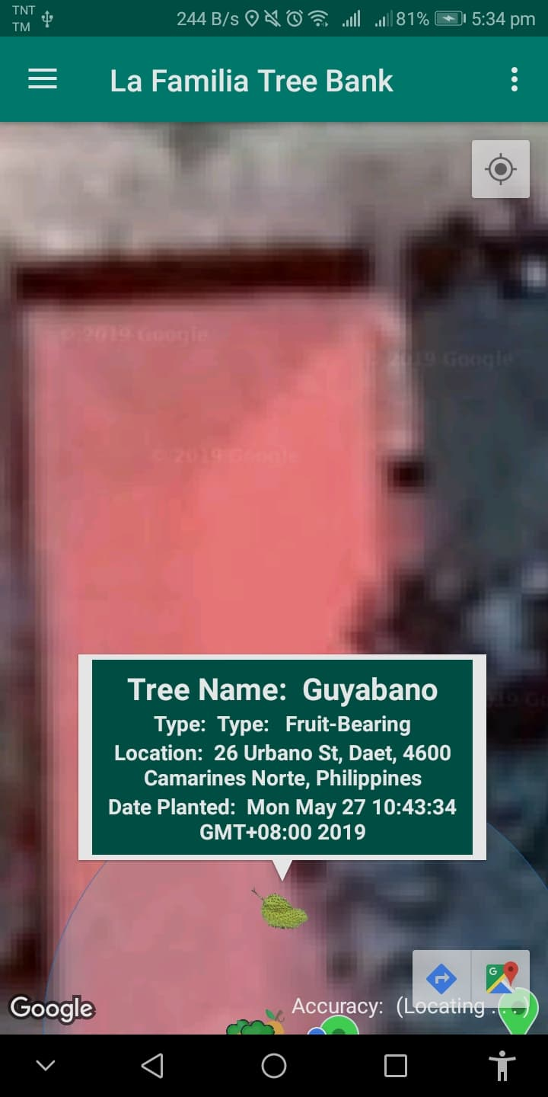
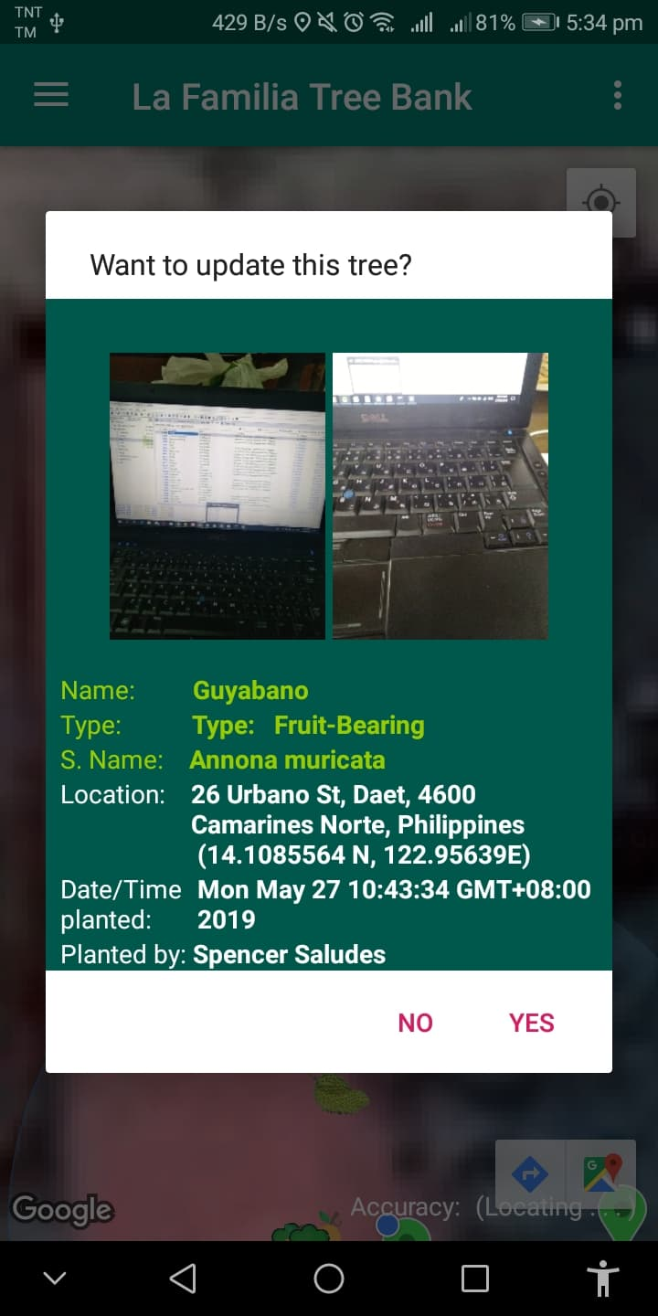
My Trees will show only the trees you planted and you can find here the tree that needs an update .
>> Tap the marker and you can see the Tree Information.
>> Tap yes to start updating your tree .
Note that you can’t proceed when your current location is different with the tree location.
August 2019
01/01/2018
www.website.com
33
Camarines Norte State College

Slide 23
If the location accuracy is right, the camera will appear to update the picture of the tree. Please capture only the tree while the selfie will follow.
August 2019
01/01/2018
www.website.com
34
Camarines Norte State College

Slide 24
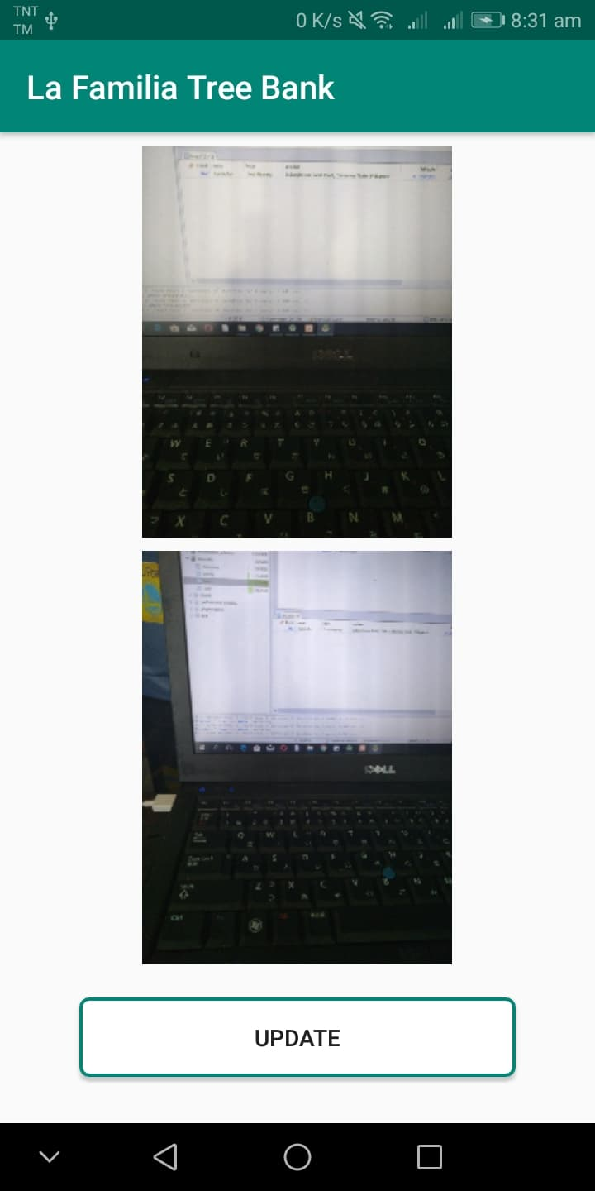
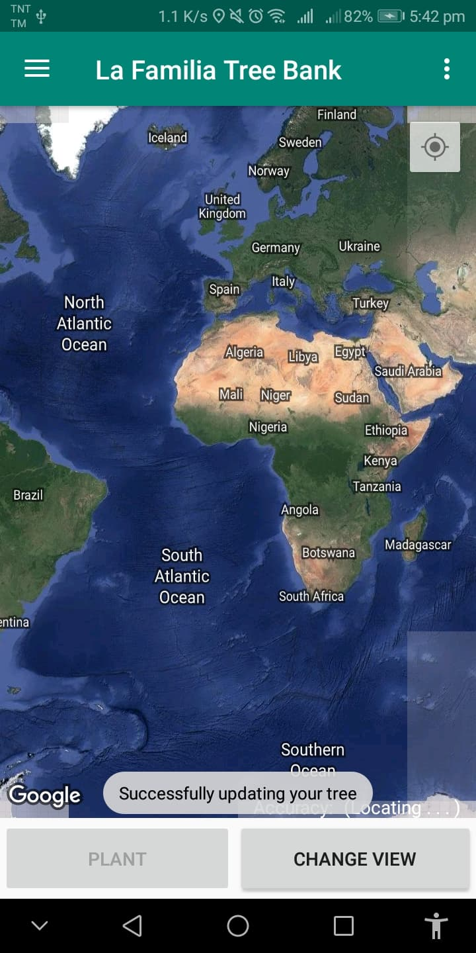
Click update to finally update your tree.
If update was successful a confirmation will appear.
August 2019
01/01/2018
www.website.com
35
Camarines Norte State College

Slide 25
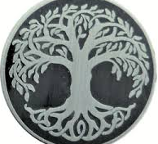
La Familia Tree Bank App: User Guide
BADGES
Part of student compliance in their clearances is tree savers’ badges. Apart from database, student can present their badges for clearance. A specific badges for every semester is mandatory to be completed.
For every level of tasks a student accomplished, they will receive an electronic badge thru the Facebook page, students will be reminded what badges are needed for a specific semester.
Updated Tree
Planted without die
Always with
Curiosity
Planted 1 Tree
Soft- Handed
Fully Grown Tree
Updated Tree
Birthday Gift
August 2019
01/01/2018
www.website.com
36
Camarines Norte State College
Notes:
Completing all the badges, students will be given recognition/award on their graduation or recognition day.

Slide 26
How to Earn Badges?
Post @ Tree Banking Facebook Page( 3 photos) before, during and after you plant or update your tree. The more likes you received in your post the more chances of getting badges. Badges may be converted into gift checks/coupons.
2. Submit to Green Initiative Channel a 3-minuter video blog of your planting activity. Similarly the more likes you received in your post the more chances of getting badges.
3. You may also share in our My Tree Stories Blog a short story telling of your experiences and learnings from your planting activities.

Slide 27
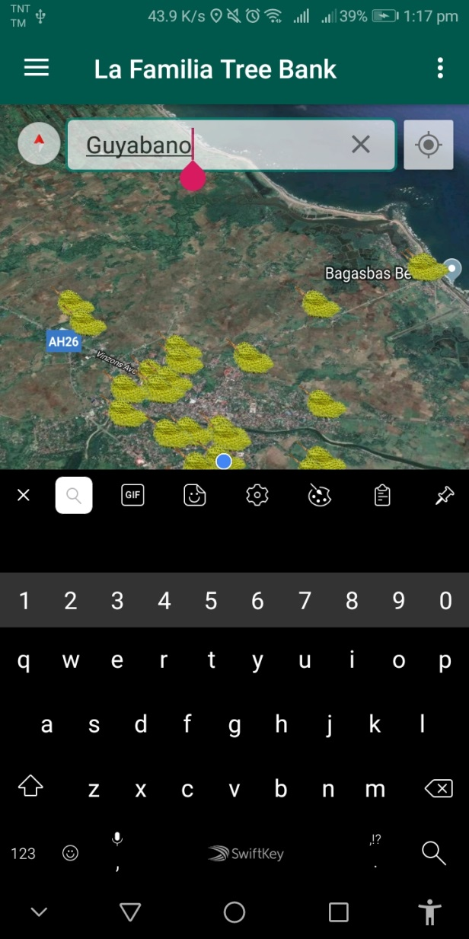
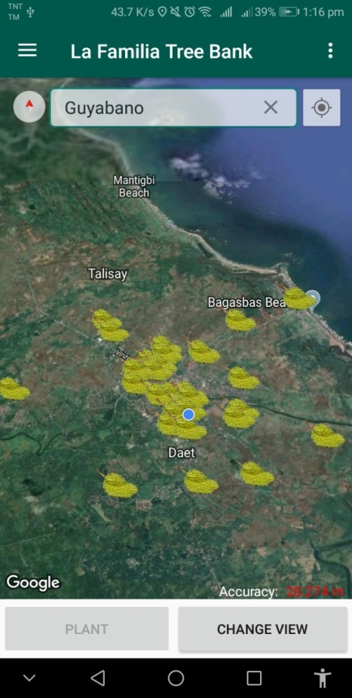
SEARCH A TREE
You can search for different trees in the search box to view the specific tree name (Mango, Cacao, etc.) while your tree is available to My Trees.
August 2019
01/01/2018
www.website.com
37
Camarines Norte State College

Slide 28
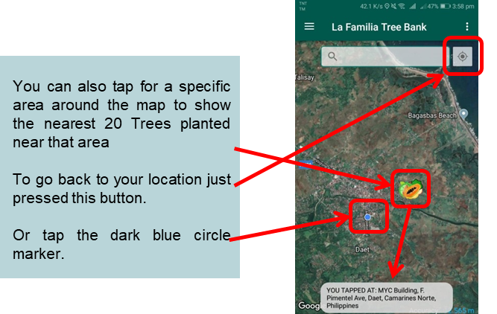
August 2019
01/01/2018
www.website.com
38
Camarines Norte State College

Slide 29
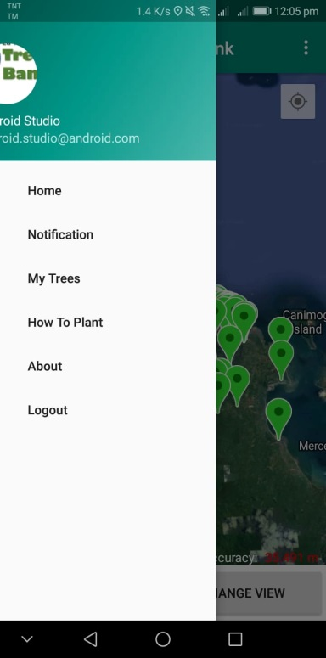
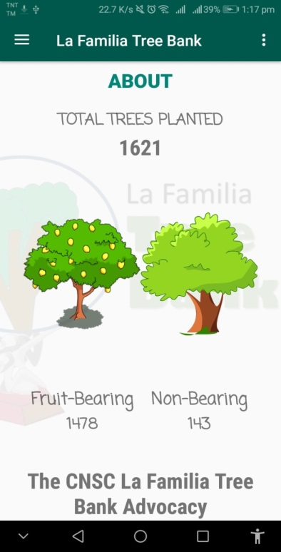
ABOUT
Displays the total number of tree planted and documented using the app (Fruit and Non-fruit Bearing).
It also display some information about the Advocacy.
Count
Student vs. Others
Municipality A vs. Municipality B
Province A vs. Province B
Region A vs. Region B
Female vs. Male
By Age Range
BY Sector
Others
August 2019
01/01/2018
www.website.com
39
Camarines Norte State College

Slide 30
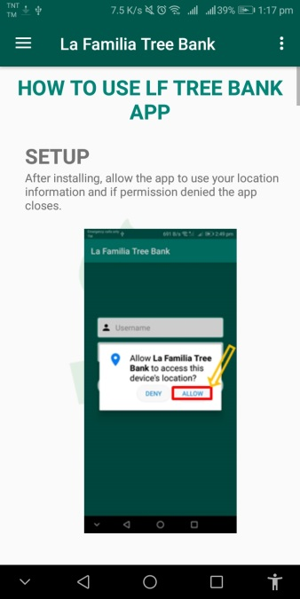
How to Plant?
Manual is also available in the app.
Links will be provided for other ways to plant a tree.
24
August 2019
01/01/2018
www.website.com
40
Camarines Norte State College

Slide 31
DONATE
WE ACCEPT DONATIONS VIA:
GCASH (09568127007) or
Through College Cashier
August 2019
01/01/2018
www.website.com
43
Camarines Norte State College
26

Slide 32
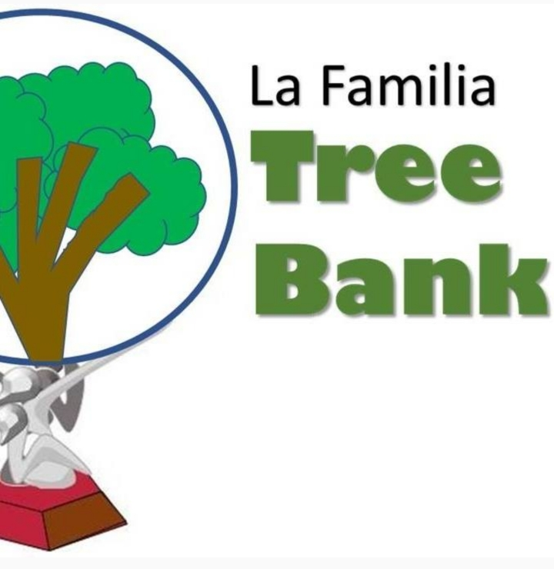
HOW TO GET THE TREE BANK APPS
1. Like us on Facebook. Message a request for “tree bank apk” and provide your name, school/agency, year level/occupation and email
This App will be made available at Google Play once adopted by DENR or by CHED as a standard tool for Tree Banking. Other feature are in the works to make the system more useful.
CNSC intends to become the ENGP Center in the Region.
Tree Bank App: Tool for the National Greening Program
through http://cnsc.edu.ph/lafamilia/download_apk.php
2. Soon, it can be downloaded from Google Play.
August 2019
01/01/2018
www.website.com
43
Camarines Norte State College
26

Slide 33
Institutional Planning and Development Office
Camarines Norte State College
F. Avenue, Brgy. II, Daet, Camarines Norte

